Slide 1
Where to find the presentation
https://drive.google.com/drive/folders/17UT5YDxyAZluaYj37lI6r7fyqwG12Prp?usp=sharing
‹#›

Slide 2
Background
Crop yield forecasts are useful to many stakeholders (e.g. farmers, commodity traders, agronomists, policymakers).
European Commission’s Joint Research Centre uses the MARS Crop Yield Forecasting System - a suite of tools for analysts - to provide regular forecasts to policymakers at DG-AGRI and member states. MCYFS forecasts are based on statistical regression analysis, similarity analysis and expert judgment.
Yield statistics
Trend analysis
Yield trend
Crop Model Simulation Outputs
Yield residuals
Crop yield forecasts
Weather indicators
Regression analysis
Remote sensing indicators
Similarity analysis
‹#›

Slide 3
Problem Definition
Predict crop yield using
outputs of crop growth simulation models (e.g. WOFOST)
weather observations
remote sensing indicators
soil
regional yield statistics
Data from MARS Crop Yield Forecasting System and Eurostat.
Design a workflow to explore the potential of Machine Learning in large-scale crop yield forecasting.
Run the same workflow across Europe for several crops.
Predict at different points during the crop growing season.
Make yield predictions at regional level and aggregate to national level to compare with MCYFS predictions.
Analyze regional patterns seen in regional forecasts.

Slide 4
Machine Learning Baseline
Baseline: A machine learning workflow focused on correctness, modularity, reusability.
Easy to run: Something like Auto ML to get baseline results.
Data
Preprocessing
Training, Test Split
Feature Design
Feature Scaling
Feature Selection
Training, Testing
Results
Homogenize data format and align data to same spatial and temporal resolutions
Split into training, validation and test sets
Infer crop Calendar. Create Max, Avg and Count aggregations
Bring feature values to similar ranges
Pick the most predictive features
Train and Evaluate Algorithms
Interpret results, adjust settings and rerun (if necessary)

Slide 5
Feature Design
Using WOFOST data, we inferred crop calendar periods for each crop. For each period, we identified the indicators that affect or capture the state of crop growth and development.
Period | Maximum Values | Averages, *Cumulative Sums, **from previous year | z-scores based on long term avg, std
Pre-planting window |  | TAVG, PREC, CWB*
Planting window |  | TAVG, PREC | RSM, TMIN, PREC
Vegetative phase | WLIM_YB, TWC, WLAI | RSM, TAVG, CWB*, FAPAR, RAD | RSM
Flowering phase |  | PREC | RSM, PREC, TMAX
Yield Formation phase | WLIM_YB, WLIM_YS, TWC, WLAI | RSM, CWB*, FAPAR, RAD | RSM
Harvest window |  | PREC** | PREC**
Notes:
Try same length periods without WOFOST data - Hiske
Try other indicators even if redundant - Hiske

Slide 6
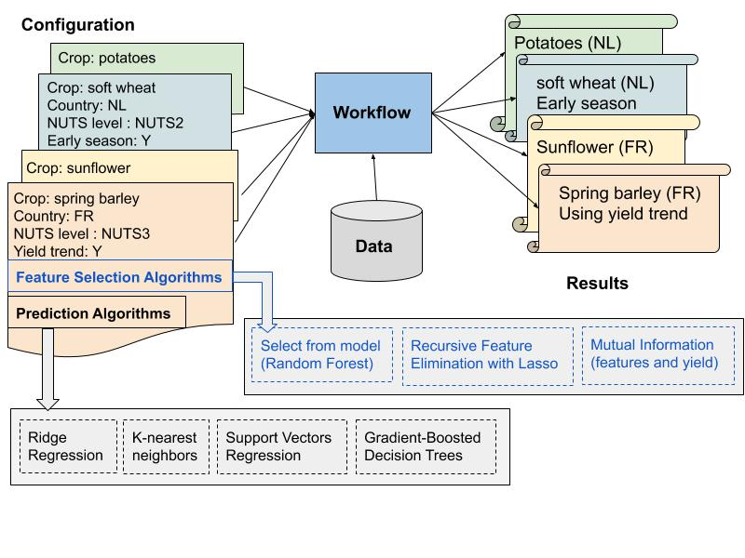
Modularity and Reusability

Slide 7
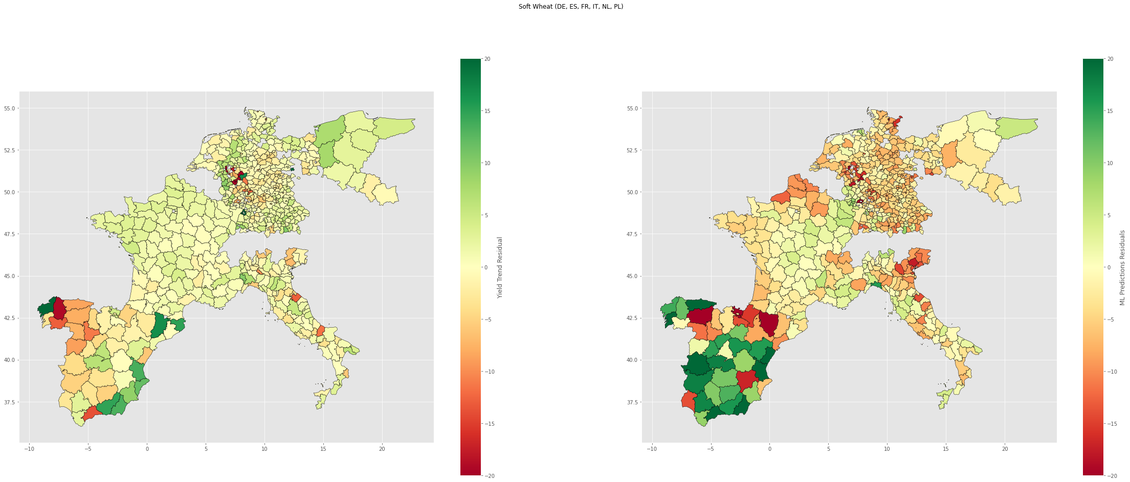
Visualizations for regional data, predictions
Analyzing predictions and residuals
https://colab.research.google.com/drive/1fuCvXoGASnaBCoEdP53Iuc30veGJmH6G#scrollTo=YK7UzM50xQ9k

Slide 8
For interested participants
Change crop, end of season dekad
Compare performance of an additional algorithm (use mlbaseline.ipynb)
Use Deep Learning. Use crop_yield_DL_performance.ipynb from dlinterpret branch)

